Slide 1
Weekly Report
12/5//22
Erin Ingram & Omar Mahmood
NanoBio Systems Lab
Texas A&M University

Slide 2
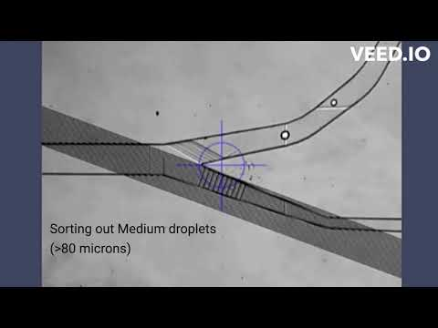
Progress
Experimentation with band-pass filter device
Video:

Slide 3
Additional Progress
Corrected high-pass filter printed
Additional copies fabricated
403 Demo completed
Achieved a grade of 95%

Slide 4
Thank you for your time!

